Slide 1

Running Your Own ChatGpt: Unlocking the Power of Local LLMs
Chris McCabe

Slide 2
Why run your own LLM?
Privacy
Flexibility
Uncensored usage
Fun

Slide 3
Privacy
Data never leaves your machine
No Third-Party Exposure
Comply with Data Regulations

Slide 4
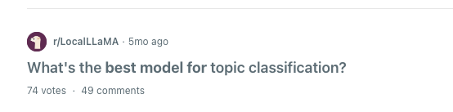
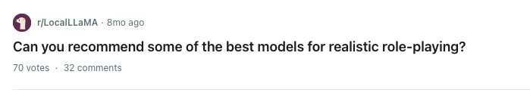
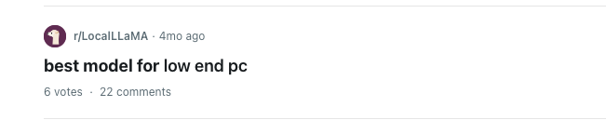
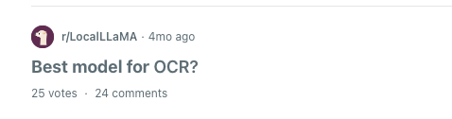
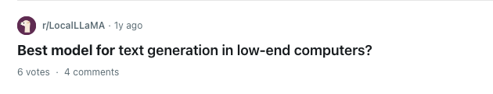
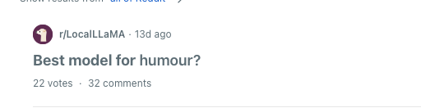
Flexibility - Different models

Slide 5
Flexibility of different models
{ 'model': 'hermes3:8b', 'time': 5.77803897857666, 'mappings': { 'data': [ { 'name': 'McApple', 'score': 1 }, { 'name': 'iFruit', 'score': 4 }, { 'name': "Steve's Apples", 'score': 3 }, { 'name': 'Big Apple Tech', 'score': 2 }, { 'name': 'Apple Inc.', 'score': 5 }, { 'name': "Newton's Rival", 'score': 2 }, { 'name': 'Green Apple Computers', 'score': 1 }, { 'name': 'The Red Delicious', 'score': 3 }, { 'name': 'Crisp Tech', 'score': 4 }, { 'name': "Granny's Smith", 'score': 2 } ] } },
{ 'apple': 10, 'Apple Inc.': 9, 'Apple Computer Inc.': 8, 'Apple Products Inc.': 7, 'Apple Technology Group': 6, 'Apple Technologies': 5, 'Apple Computer Corporation': 4, 'Apple Computer': 3, 'Apple Computer Co., Ltd.': 2, 'Apple Computer, Inc.': 1 }
'model': 'llama3.1:latest', 'time': 8.427261352539062, 'mappings': { 'Big Apple': 0.5, 'The Fruit Company': 0.2, 'iCompany': 0.8, 'Apple Inc.': 0.1, "Steve's Gadgets": 0.3, 'The Tech Giant': 0.6, 'New Apple': 0.4 } },
Generate a list of alternative names used for the organization '{organization_name}' with a score on how likely they are to be used. Return a list with keys using the keys `name` and `score`.

Slide 6
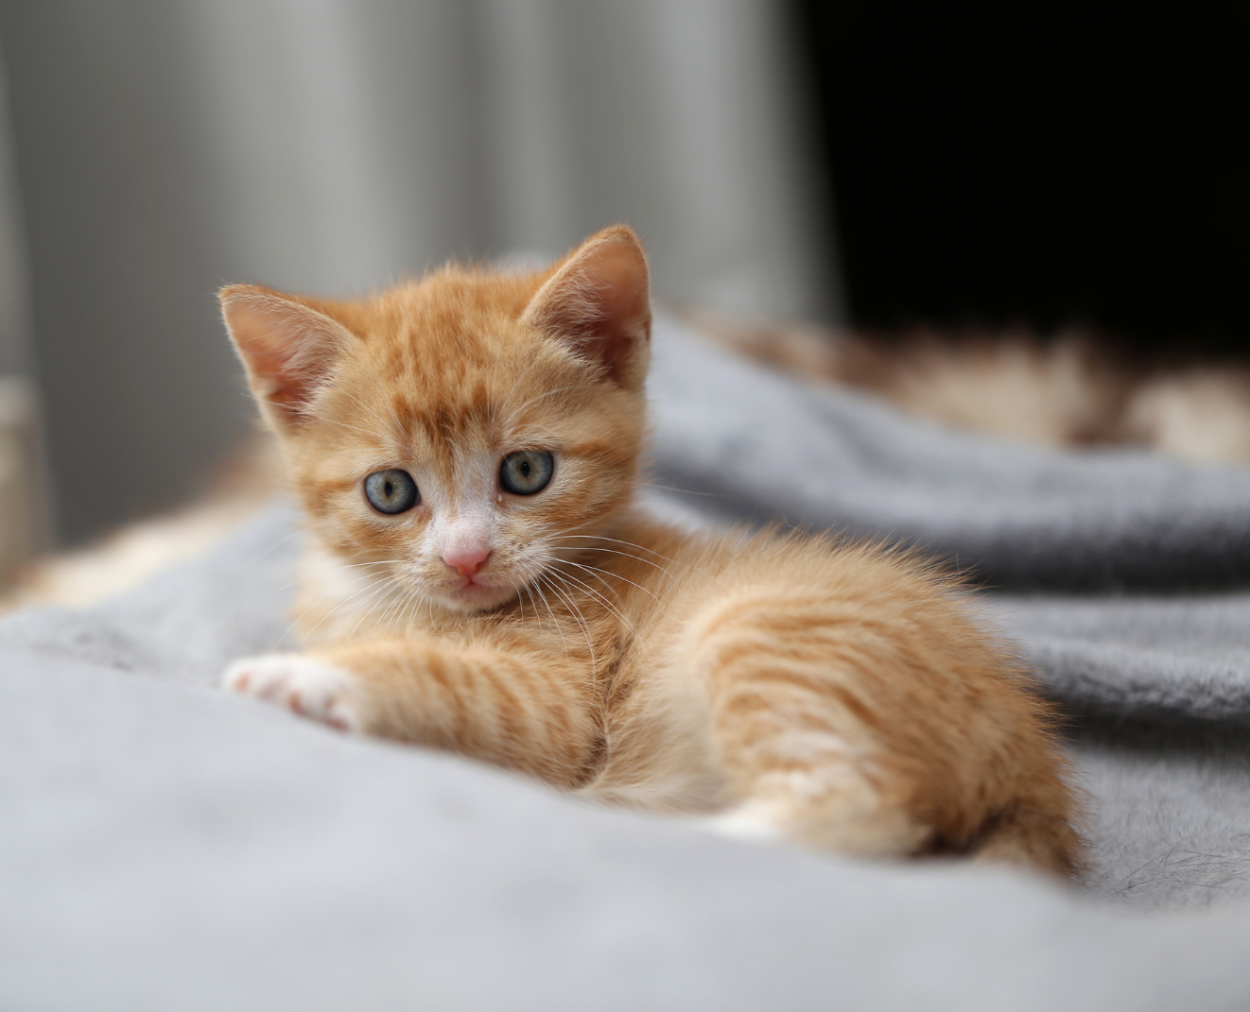
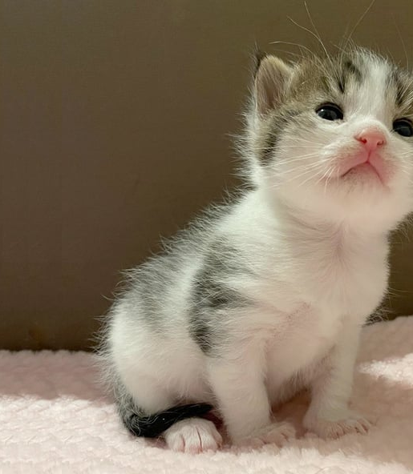
Using uncensored/jailbroken models

Slide 7
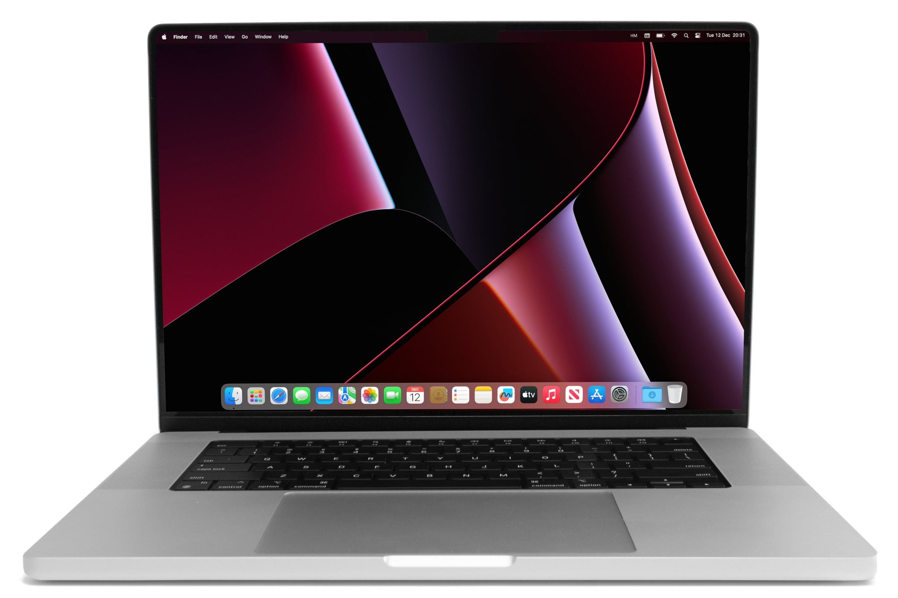
System requirements
I’m using an m2 with 64GB RAM and 2TB HDD
32GB RAM

Slide 8

Key terms
Parameters
Tokens
Context length
Temperature
Abliterated

Slide 9

Parameters

Slide 10


Parameters
When discussing Large Language Models (LLMs), the term "parameters" refers to the number of learnable weights or connections within the neural network architecture.

Slide 11
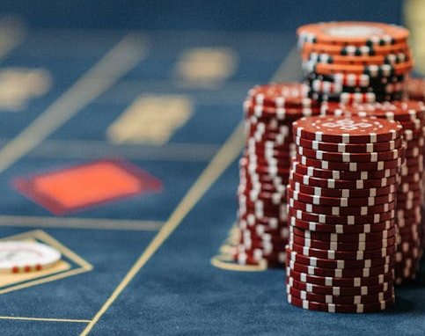
Tokens

Slide 12
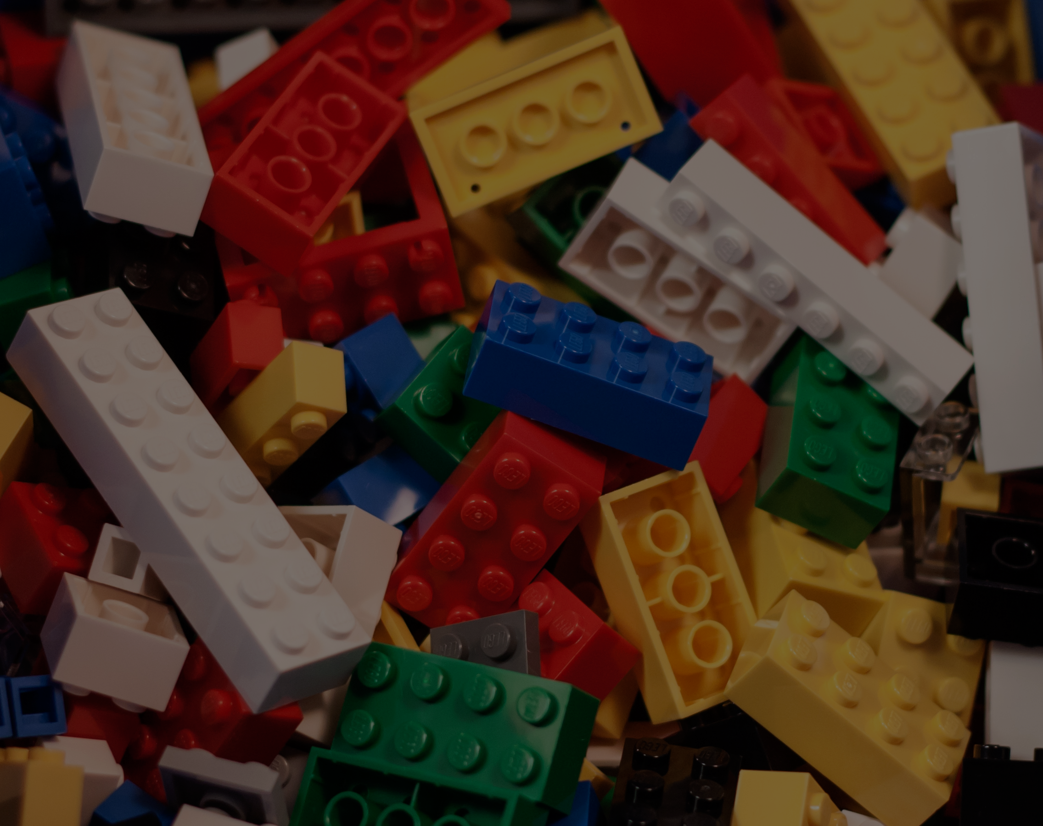
Tokens
tl;dr Tokens are the units or building blocks that LLMs use to process language.
Open AI uses "Byte-Pair Encoding (BPE)".
Consider the phrase "Hello, world!".
It's thirteen total characters and ends up being four tokens:
"Hello"
","
" world"
"!"

Slide 13
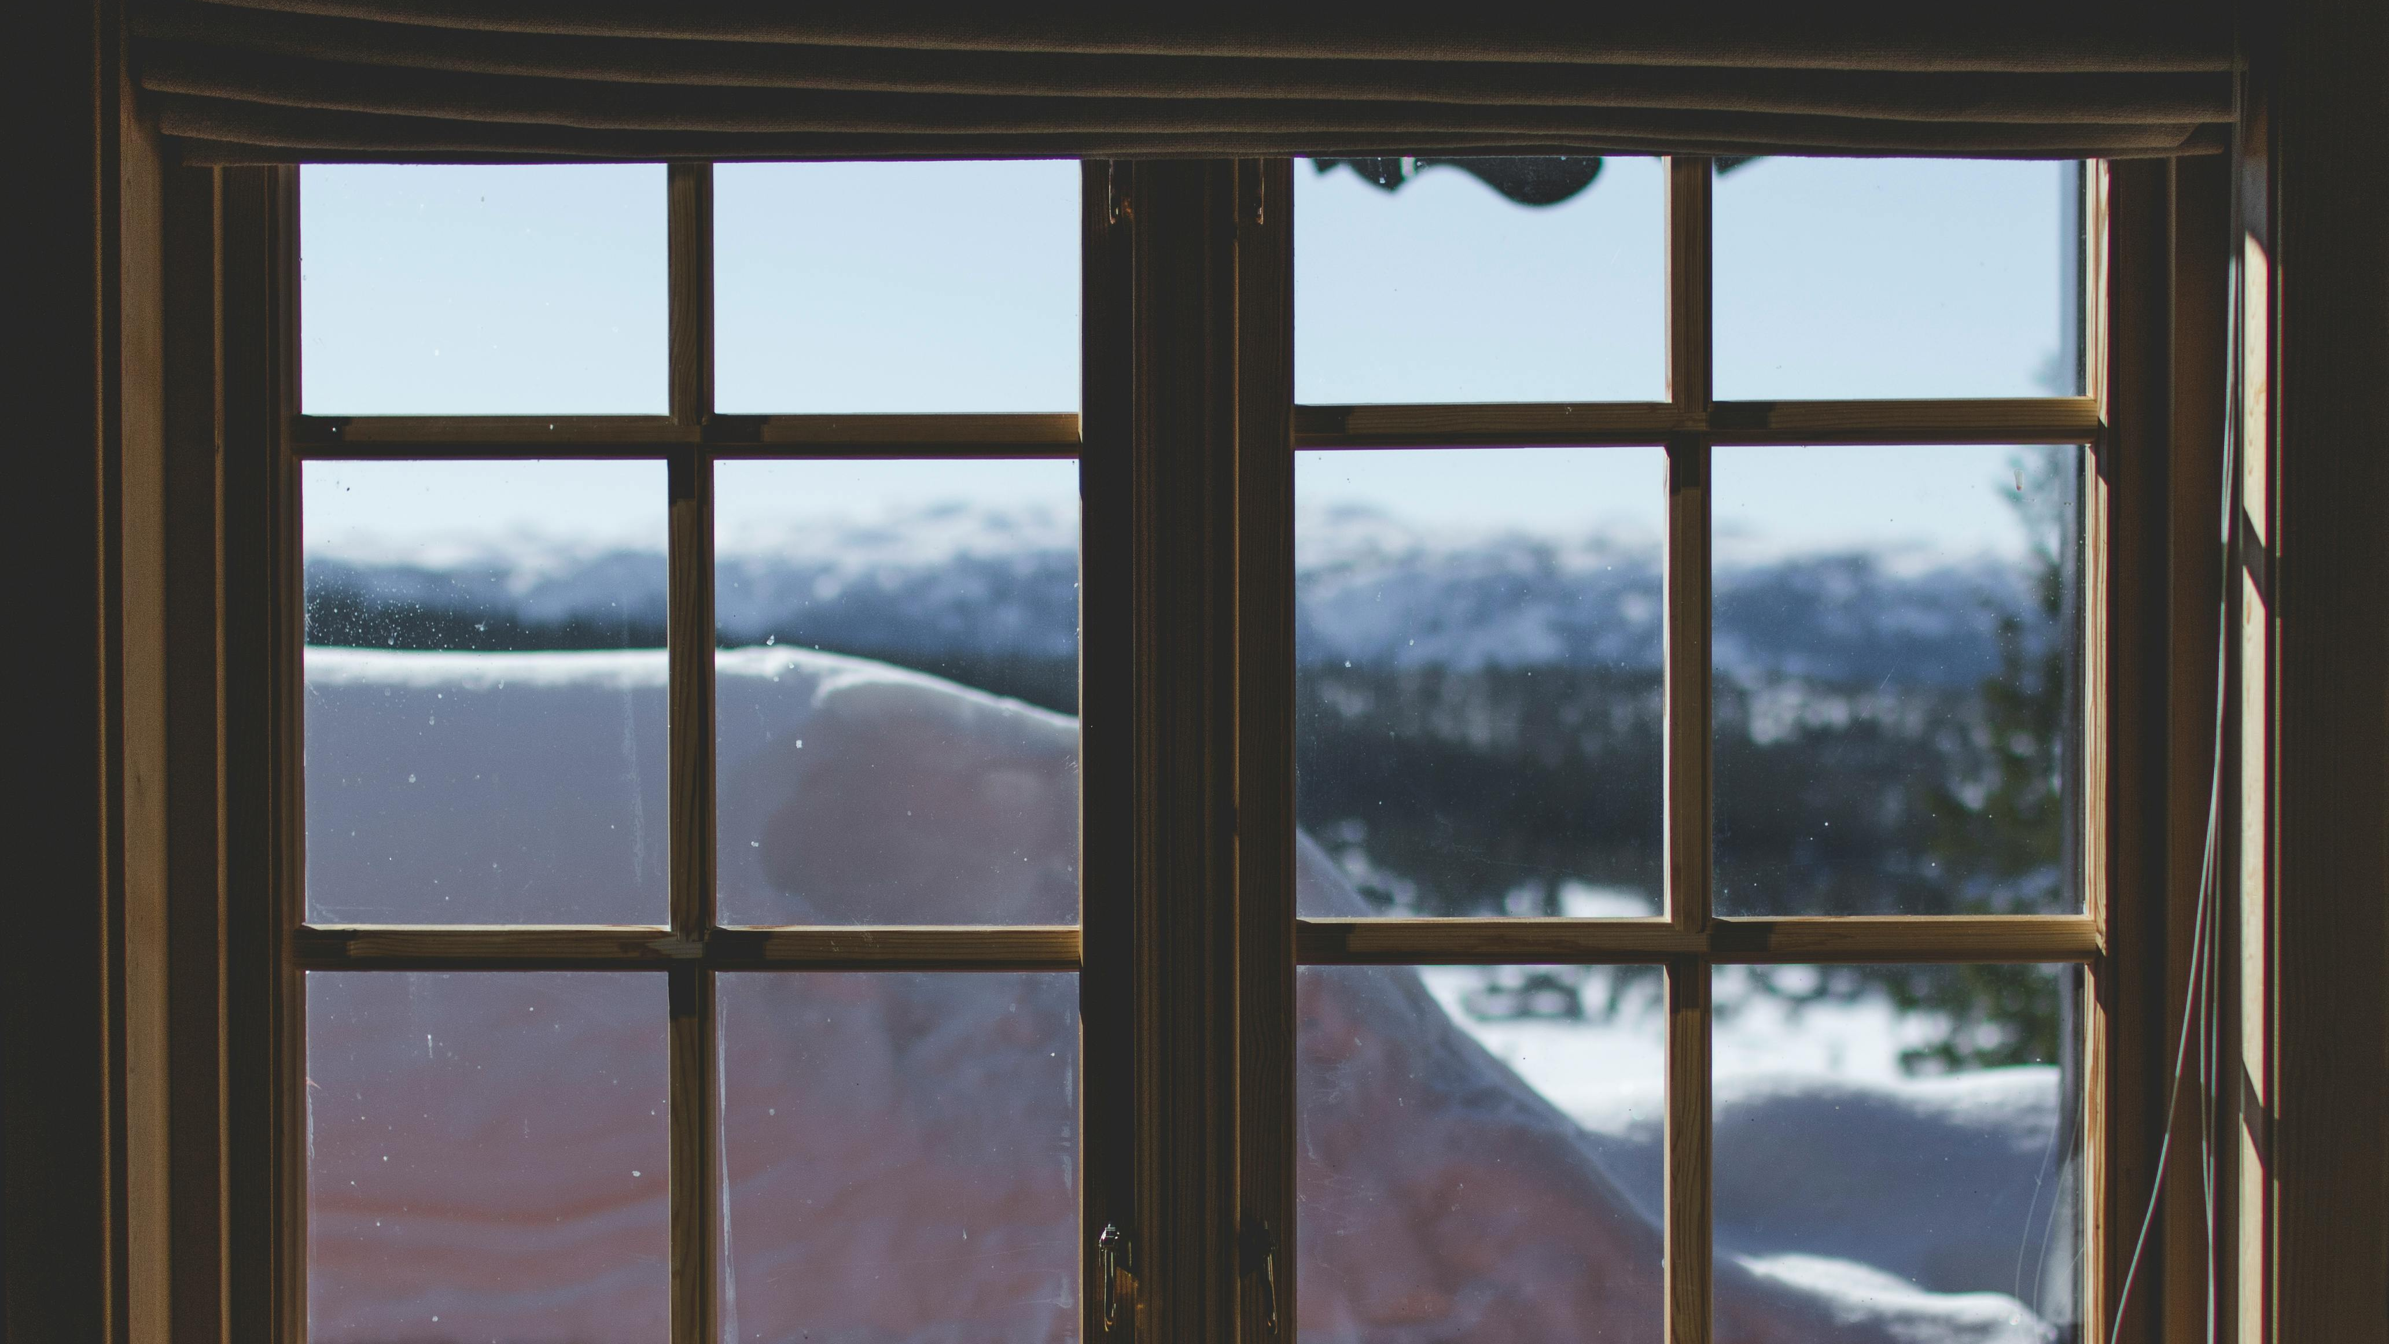
Context length

Slide 14

Context length
Context Length refers to the maximum number of tokens
(such as words, characters, or subwords) that the model
can consider when generating text or making predictions.

Slide 15
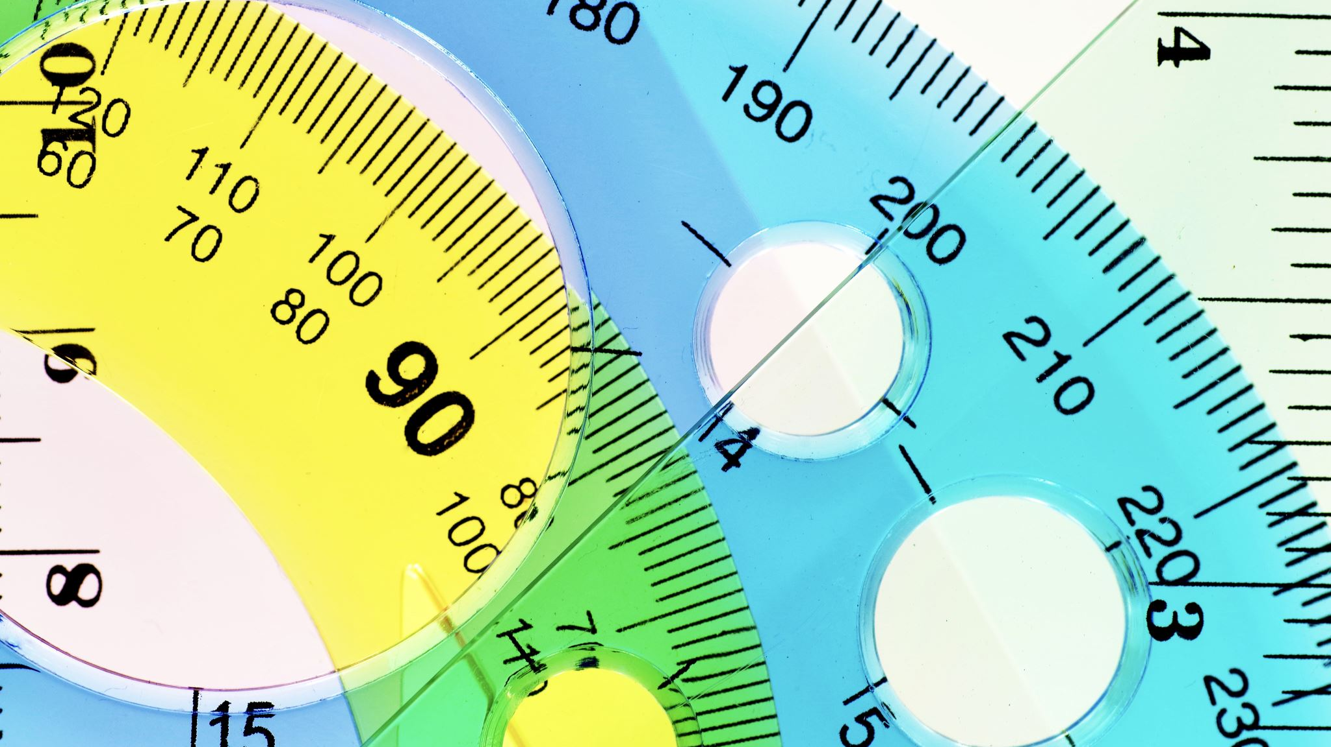
Temperature

Slide 16

Temperature
Temperature Is a hyperparameter
that controls the level of randomness or "softness" in the model's output.

Slide 17
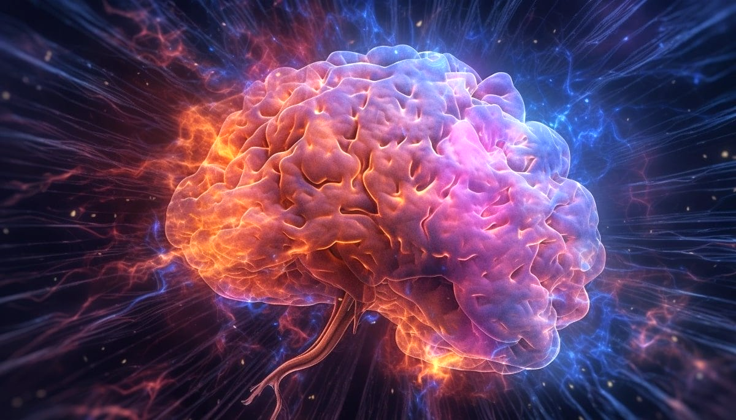
Abliterated

Slide 18
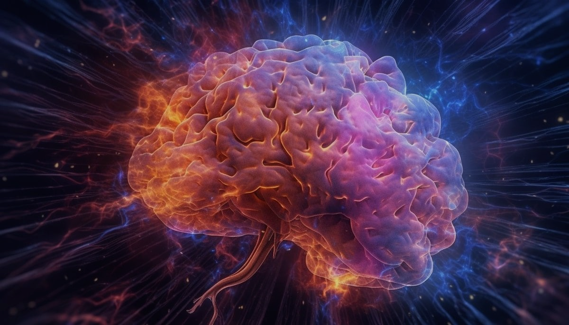
Abliterated
A technique designed to override safety mechanisms in language
models that typically prevent them from responding to certain prompts.
By using "abliteration," users can bypass built-in refusals or restrictions,
allowing the model to answer questions it would normally avoid.
This process involves fine-tuning the model or
manipulating its outputs to reduce or remove these restrictions,
enabling more open-ended and unrestricted interactions.
https://huggingface.co/blog/mlabonne/abliteration

Slide 19
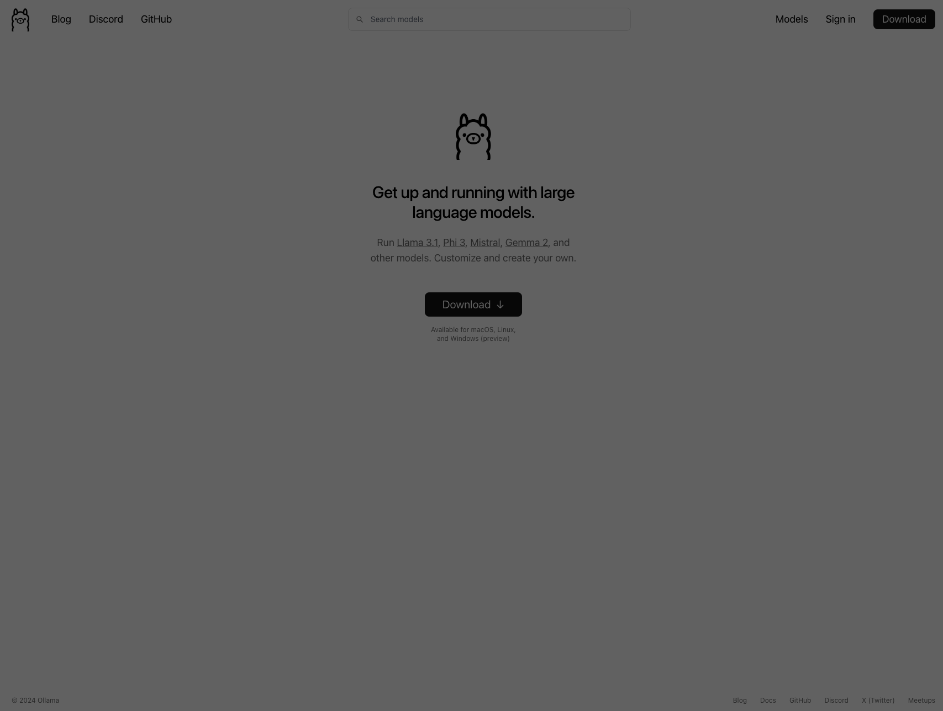
Setup

Slide 20
Setup Local LLM- The easy way
Install ollama
Download models
Serve the models
Run the ui
Chat!

Slide 21
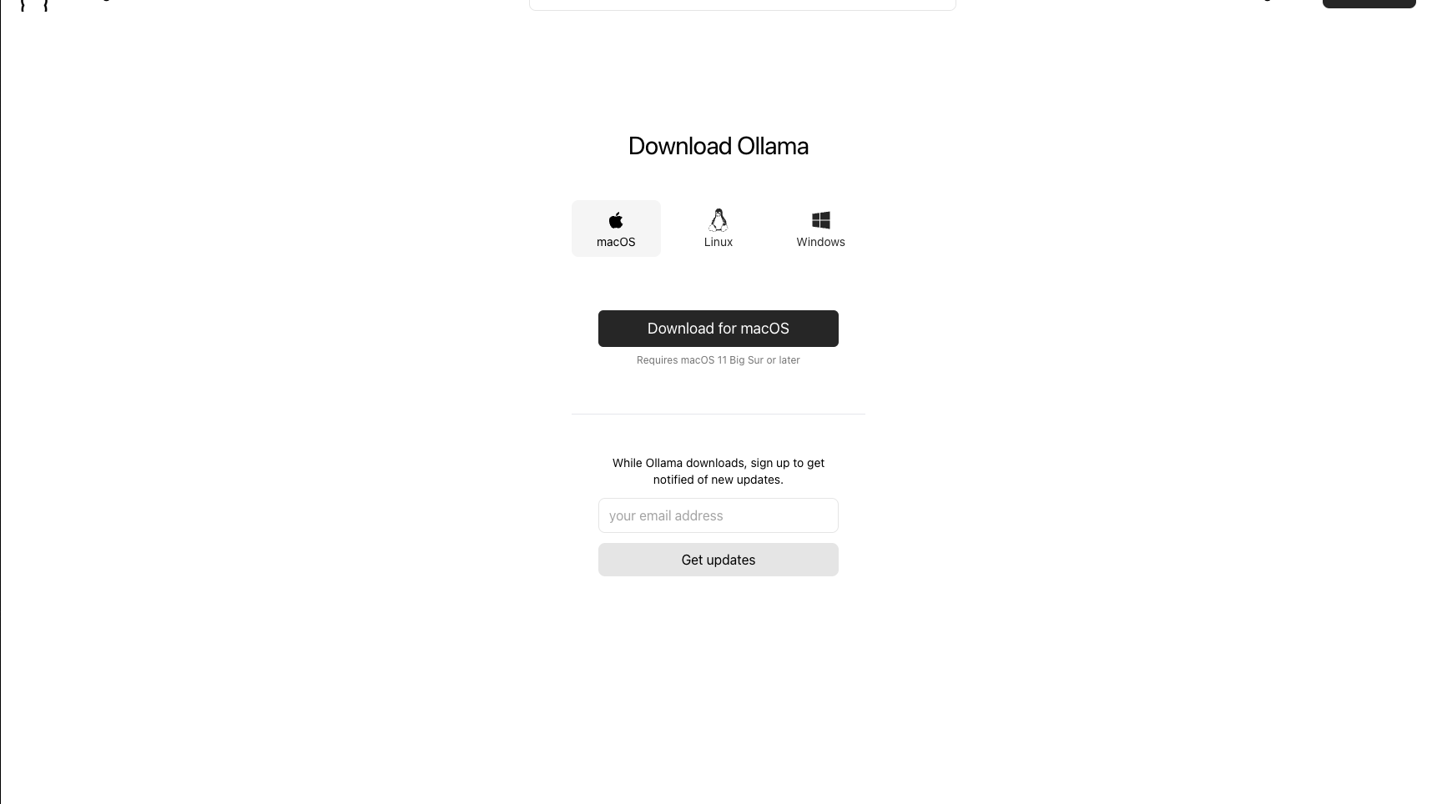
https://ollama.com/download/mac
brew install ollama

Slide 22
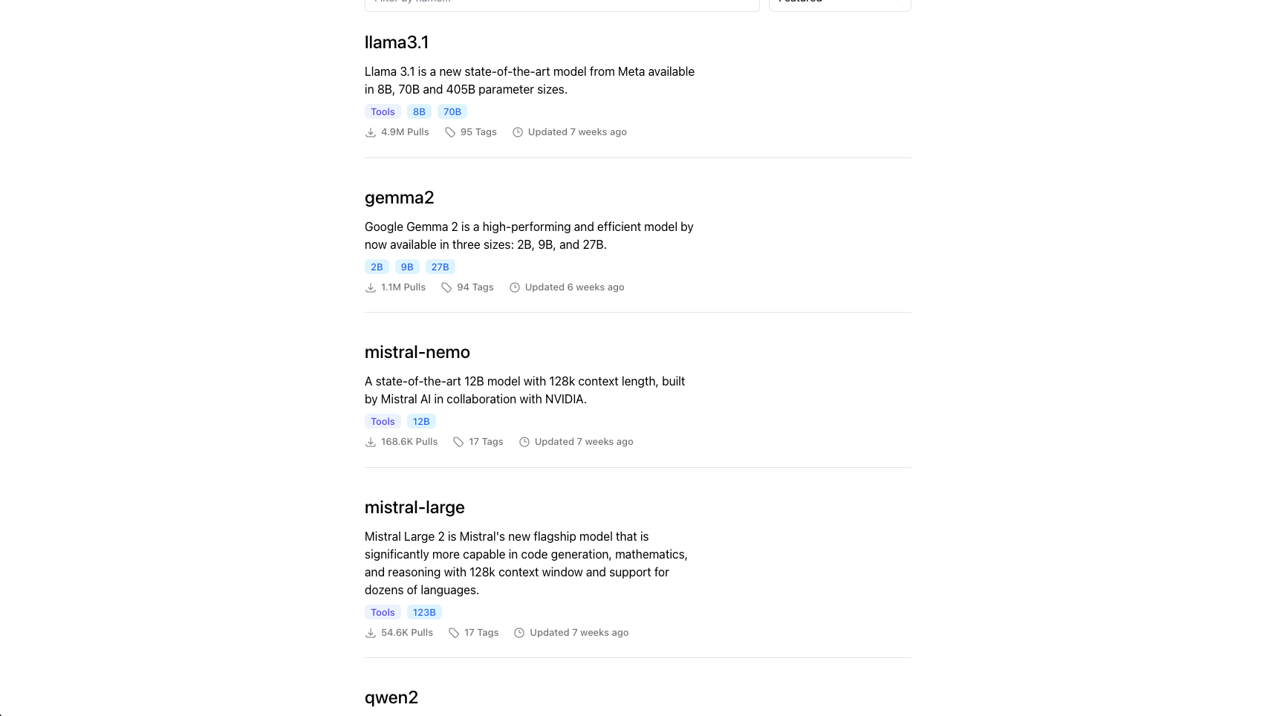
https://ollama.com/library

Slide 23

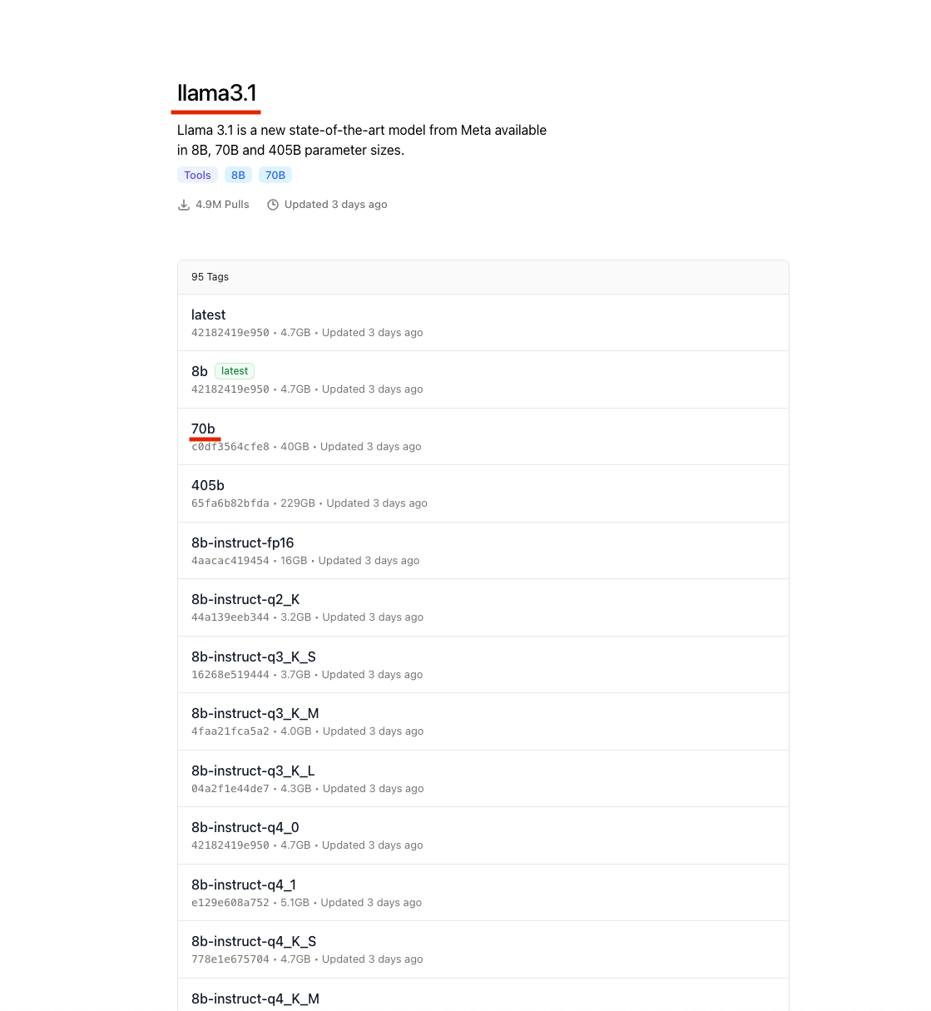
% ollama pull llama3.1:70b

Slide 24
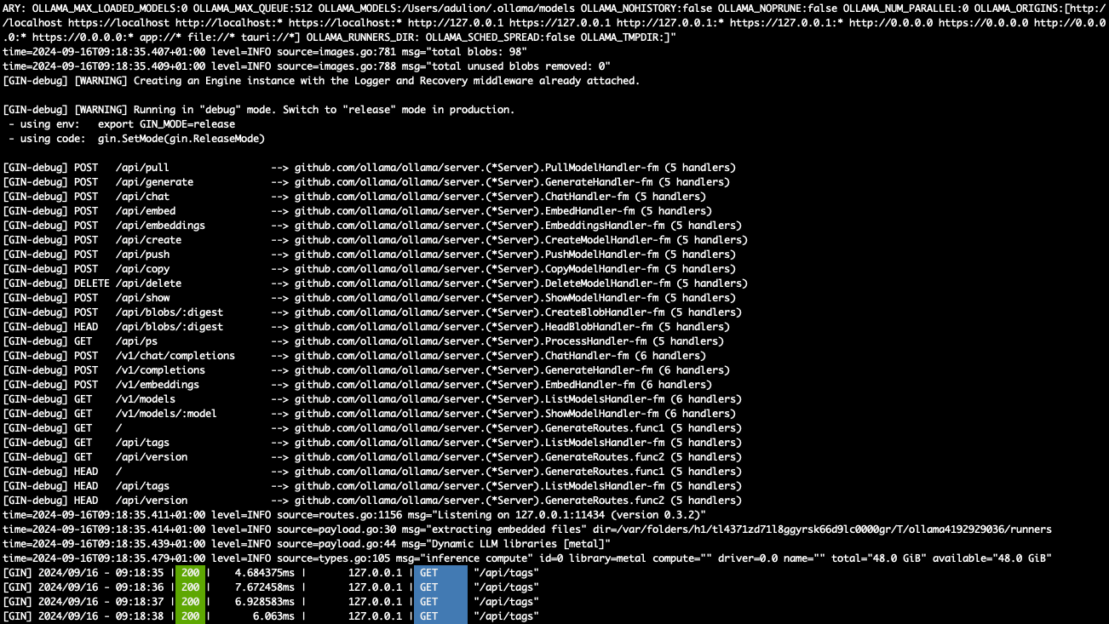
% ollama serve

Slide 25
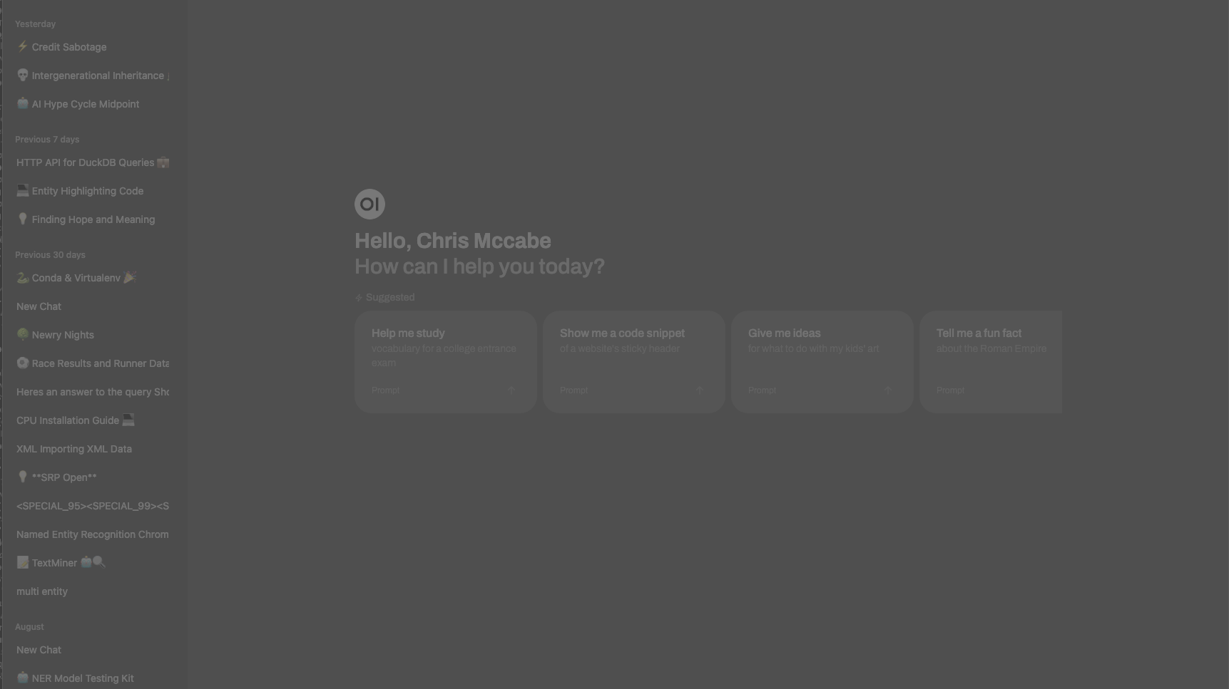
open-webui
% docker run -d -p 3000:8080 --add-host=host.docker.internal:host-gateway -v open-webui:/app/backend/data --name open-webui --restart always ghcr.io/open-webui/open-webui:main
https://github.com/ open-webui/open-webui

Slide 26
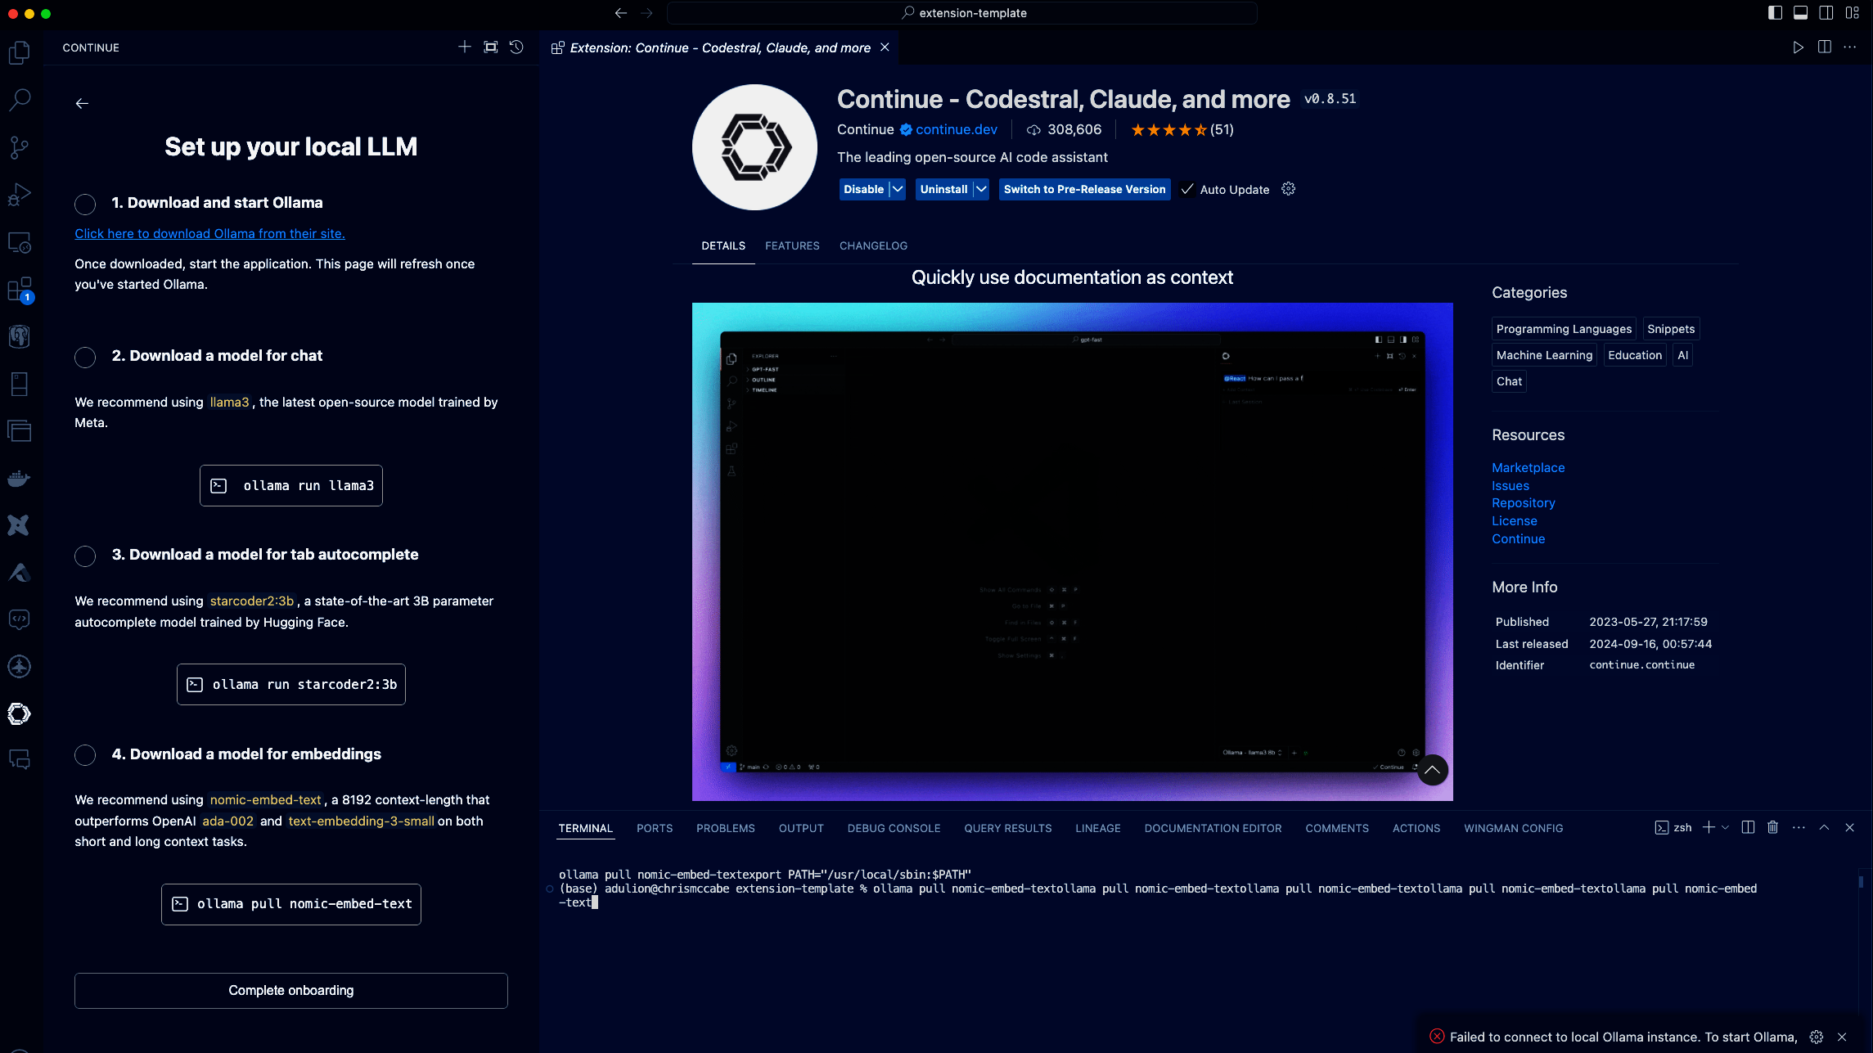
Running your own copilot
https://www.continue.dev/

Slide 27
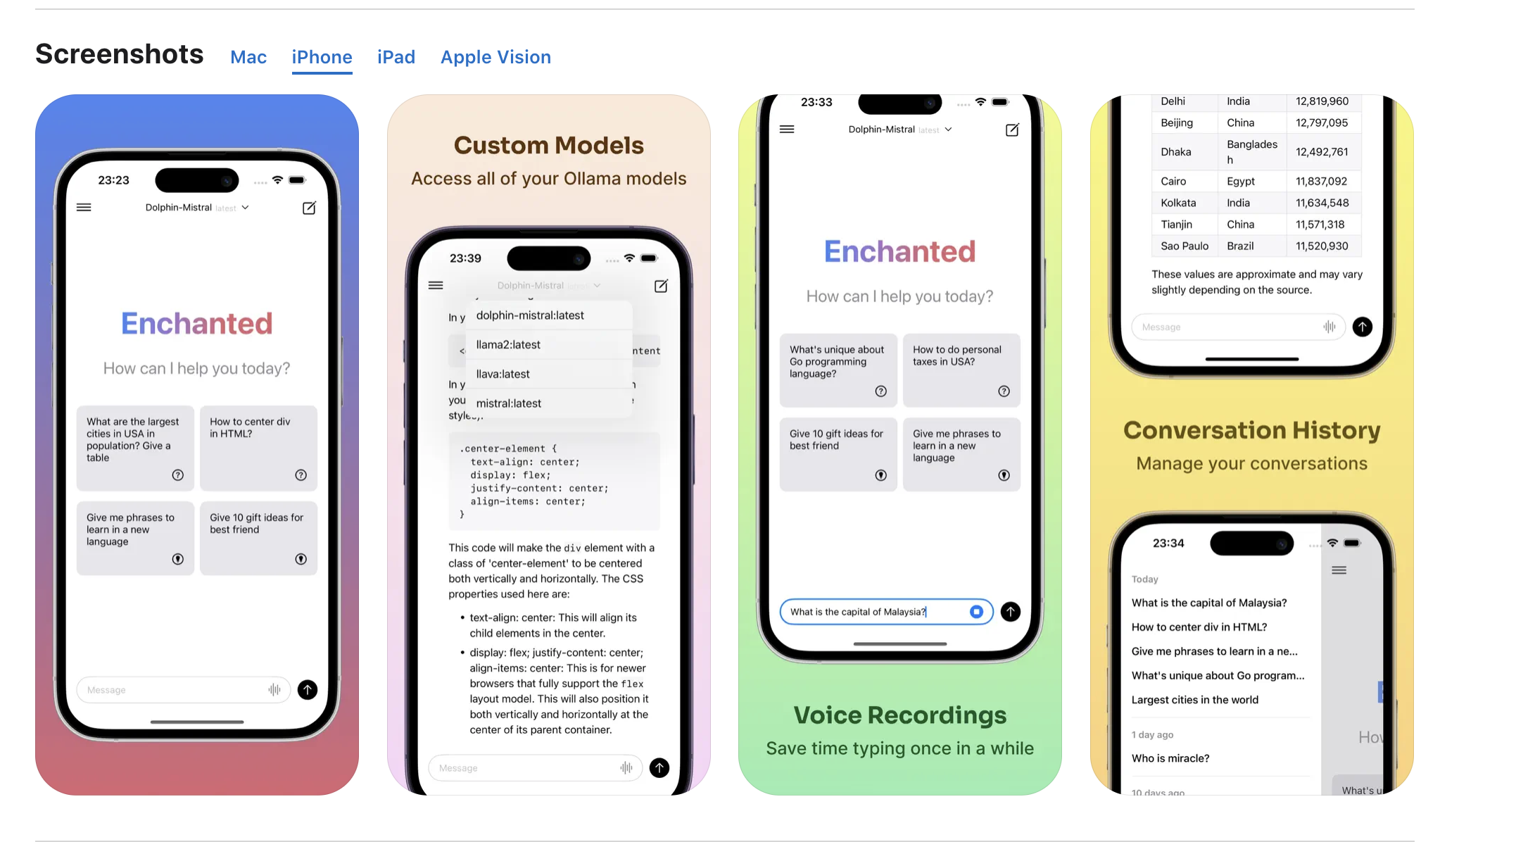
Enchanted LLM

Slide 28
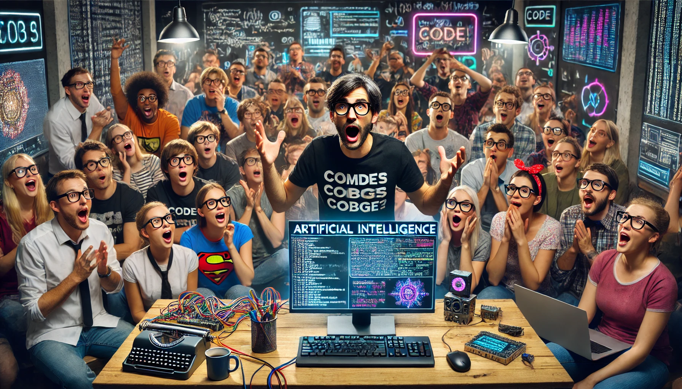
Demo

Slide 29
Reflection
Key terms
Installation of ollama
Serving the UI
Comparisen of models
Using ablirated models
Running Local Model based “copilot”
Replacing openai python calls with Ollama
Using Ollama with langchain

Slide 30
Resources
Huggingface
https://reddit.com/r/LocalLLaMA
https://ollama.com

Slide 31

Add me on linkedin
Get the Slides

